Slide 1

Predicting Severity of Traffic Accidents
Seth Ofori-tWum

Slide 2
The Problem:
Traffic accidents have always been an ongoing risk and problem
These accidents affect many that are involved, whether it is financially, psychologically, or physically, their impact is felt.
We could predict the severity of an accident based on factors such as time of day, weather, road conditions, location and boundless other variables that exist in the world.
If the City of Seattle municipal government knew the conditions ahead of time, they would be able to predict the potential risk for an accident and how severe this accident could be during those conditions and take preventative measures.

Slide 3
The Data
Traffic Records Group who collected over 200k cases with information pertaining to the details of the incidents.
In this dataset weather, road conditions and light conditions are used as the determining variables
Attribute (Independent Variable) | Description
SEVERITYCODE | A code that corresponds to the severity of the collision: 1- property damage, 2 -bodily injury
WEATHER | Describes what the weather was like during the time of the accident: Clear Raining Overcast Snowing Etc.
ROADCOND | Describes the condition of the road during the time of accident: Dry Wet Ice Snow/Slush Etc.
LIGHTCOND | Describes the lighting/visibility of the road during the time of accident: Daylight Dark- Street Lights On Dusk Dawn Etc.

Slide 4
For the full data set you can go here: https://s3.us.cloud-object-storage.appdomain.cloud/cf-courses-data/CognitiveClass/DP0701EN/version-2/Data-Collisions.csv
For the meta data you can go here: https://s3.us.cloud-object-storage.appdomain.cloud/cf-courses-data/CognitiveClass/DP0701EN/version-2/Metadata.pdf

Slide 5
Methodology
Python on Jupyter Notebooks was used to analyze the data
All variables were converted into the float datatype
NaN values were removed completely from the set, and rows with variables such as: ‘Unknown’, or ‘Other’ were also removed because we only want to determine severity based on variables that are known during the incidents.

Slide 6
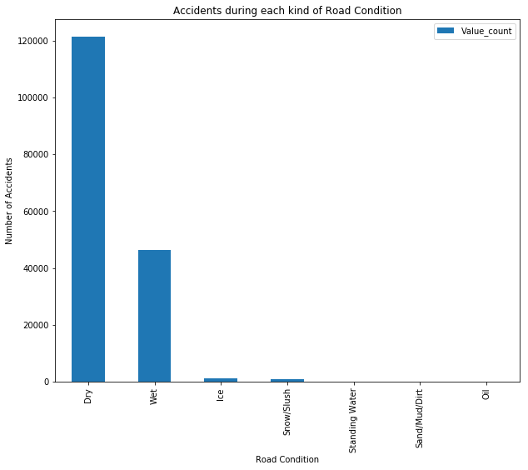
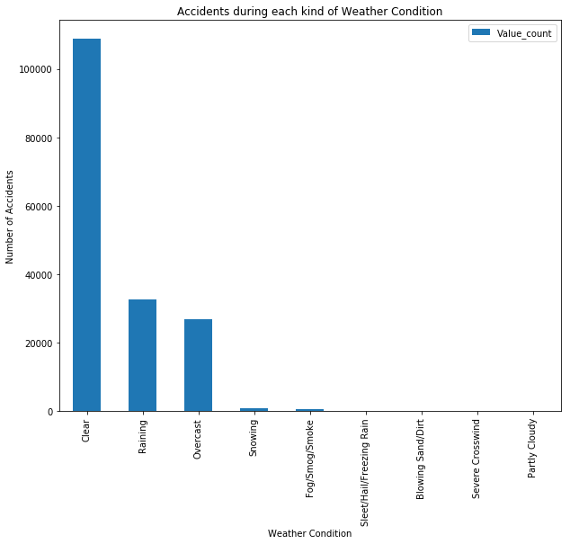
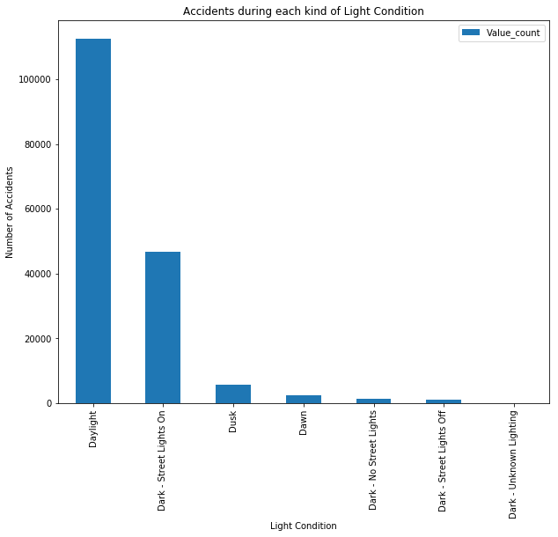
Methodology
Visualizing the relationship between the number of accidents and the determining variables

Slide 7
Methodology: Model Training
The dependant variable SEVERITYCODE data was skewed so that had to be corrected via down-sampling
The dataset was divided into a training set where the model learns the data that it will be running for application, and a testing set to actually use to predict previously unknown data.
80/20 ratio was used and felt like it would give the best repeatable results
Severity Code | Value Count
1 | 114274
2 | 55683
Severity Code | Value Count
1 | 55683
2 | 55683

Slide 8
Methodology: The Models
K-Nearest Neighbors
A type of classification model that looks to predict a class based on its proximity to similar data points on a graph.
It assumes that the points that are close to each or “neighbors” are of a similar class
The algorithm is programmed to be able to calculate similarity of data points and then return a predicted point that it believes to follow that pattern. This is exactly the type of training that was needed.
In our dataset we want to classify an incident based on its severity and its datapoints are placed on the scale using the variables chosen based on the nearest neighbors of the training set with the same variables.

Slide 9
Methodology: The Models
Decision Trees
The algorithm looks at a sample of binary classifiers and then trains the data to be divided into a node that contains one category using the criteria of the independent variables.
The data trickles down into different categories following the decision branches like a tree until the point satisfies all the variables and ends in its final category. This machine learning method is ideal.
In the case of our dataset. The model looks at the severity (binary choice) and decides which category it will most likely fall under depending on the road condition. Then it looks at the weather and decides which severity it belongs to in this case, then again it looks at the light condition where it finally decides which category to be placed in.

Slide 10
Methodology: The Models
Logistic Regression
A classification model that classifies data points based off values from the input fields.
it allows for multiple categorical variables to be used to predict probability outcomes from a binary field.
In the case of our dataset, it meets all the criteria for using logistic regression because we need to find probability of one outcome occurring or the other, using multiple categorical variables.

Slide 11
Methodology
A test for accuracy was done to determine which learning model produced the most accurate and repeatable results. The criteria for this was Jaccard similarity score and F1-score.
Model | Test Accuracy
K-Nearest Neighbors | Jaccard index: 51.52% F1-Score: 47.91%
Decision Tree | Jaccard index: 51.83% F1-Score: 49.64%
Logistic Regression | Jaccard index: 51.46% F1-Score: 50.08%

Slide 12
Results
Looking at the accuracy of the models through Jaccard index and F1-scores of the test models, it was found that all machine learning algorithms were very similar in score. However, the decision tree seemed to have the highest score Jaccard index albeit not by much as you can see in Table 3.1. but the logistic regression was highest for F1-Score.

Slide 13
Discussion & Conclusion
It is believed the best choice for machine learning model would be logistic regression as the F1-score is more relevant for this data set because we are using binary dependant variables and the logistic regression had the highest F1-score. Using this model, The City of Seattle can decide what preventative actions they can take when the input the current conditions of the road of a specific time to know the severity of the outcome.
Accuracy of the model is a problem: All models hover at around 50% accuracy. There could be many reasons for this: the data was not cleaned enough, I could have included more variables in the manipulation of the dataset, the down-sampling of the data may have an effect on the efficacy of the models, or even my train_test_split ratio may not have been ideal.

